Slide 1
xylem and phloem
Year 11 Biology
Bremer SHS

Slide 2
Learning goals
describe and contrast the structure and function of xylem and phloem tissue (sieve tubes, sieve plates, companion cells)
explain the transport of products of photosynthesis and some mineral nutrients via translocation in the phloem.

Slide 3
Warm-up
Use the words below to fill the blanks.
wind transpiration water photosynthesis light temperature chloroplasts transpiration carbon dioxide
Plants generate their source of glucose using photosynthesis.
Photosynthesis occurs in the chloroplasts of plant cells.
In order for photosynthesis to occur, plants need to take in carbon dioxide from the air, water from the ground and light usually from the sun.
Transpiration is a mechanism for moving water against gravity in plants.
Factors that affect water retention in plants include temperature, humidity, wind and light.

Slide 4
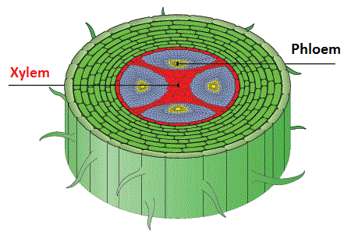
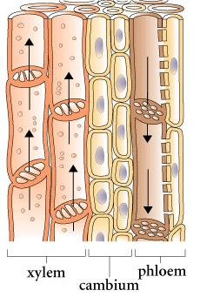
Transport in plants
The xylem and phloem are both transport vessels that combine with cambium layers to form a vascular bundle in higher order plants.
The vascular bundle functions to connect tissues in the roots, stem and leaves as well as providing structural support.
The xylem is mostly responsible for transporting water while the phloem transports glucose.
The cambium layer is an accumulation of actively dividing cells that contribute to plant growth.

Slide 5
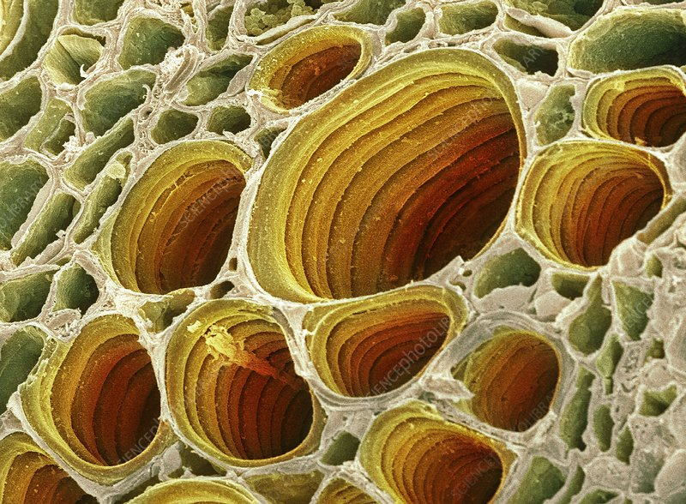
xylem
The xylem transports water and minerals from the roots to aerial parts of the plant (unidirectional transport).
It occupies the inner portion or centre of the vascular bundle and is composed of vessel elements and tracheids.
Vessel wall consists of fused cells that create a continuous tube for the unimpeded flow of materials.
Vessels are composed of dead tissue at maturity, such that vessels are hollow with no cell contents.

Slide 6
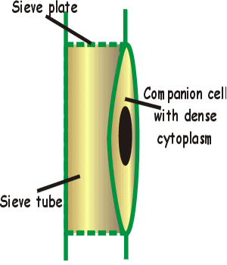
PHLOEM
The phloem is composed of still-living cells that transport sap, a water-based solution rich in sugars made by photosynthesis.
Sugars must be actively transported in to the phloem.
Sugars are transported to non-photosynthetic parts of the plant, such as the roots, or into storage structures, such as tubers or bulbs. This process is known as translocation.
Sap within the phloem travels by diffusion between cells and works its way from leaves down to the roots with help from gravity.
The phloem is made from cells called ‘sieve-tubes’ and ‘companion cells’.

Slide 7
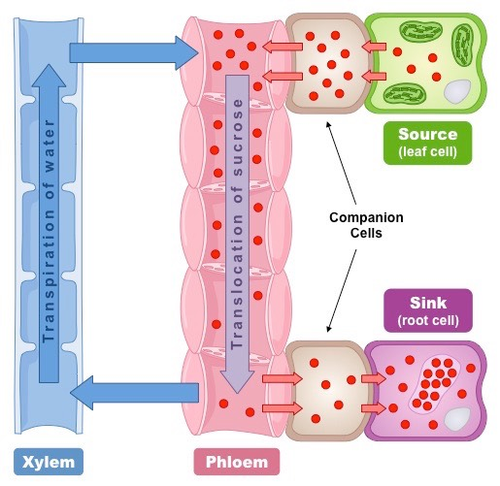
Check for understanding
Describe how the sucrose concentration changes from the leaf to the phloem and then to the roots.

Slide 8
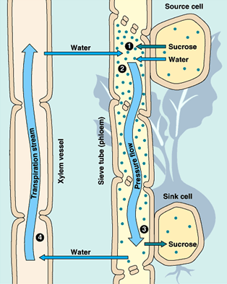
Sieve tubes of the phloem
Sieve-tubes are living cells that create chains of cells running the length of the plant.
Some sieve-tubes have porous ends called ‘sieve plates’ that allow sap to diffuse easily from cell to cell.
Water enters sieve tubes and creates a positive pressure, moving the solution from a source cell (leaf) towards a sink cell (root).
Sugars are removed from the sieve tubes at the sink maintaining the gradient creating the positive pressure that drives translocation and also stores sugar sources for later use .
The cells of the sieve-tube are missing some important structures such as a nucleus, ribosomes and a vacuole which is where companion cells come in.

Slide 9
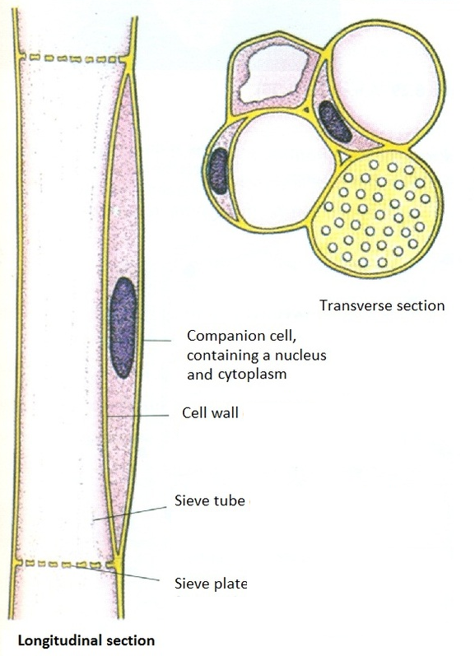
Companion cells of the phloem
The companion cells run adjacent to sieve-tube members.
Companion cells are not lacking in any vital organelles and their nucleus and ribosomes serve both the sieve-tube and itself.
Companion cells provide sieve tubes with proteins necessary for signalling and ATP in order to help them transfer molecules between different parts of the plant.
The companion cell can sometimes also deliver sugars and other substances into the sieve-tubes from neighbouring cells.

Slide 10
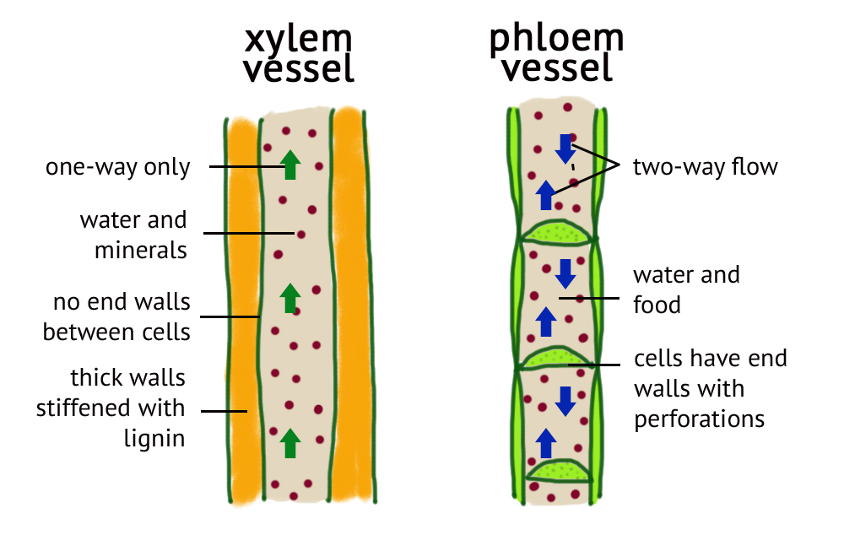
In summary…

Slide 11
Check for understanding
Use a Venn diagram to contrast the xylem and phloem.
Explain why the transport of sugars in the phloem is vital for the survival of a plant.
Explain why veins and arteries in the human body are comparable to the xylem and phloem in plants.
Sucrose is actively transported from the source cell (leaves) in to the phloem. Using your understanding of osmosis, explain why water moves out of the source cell and in to the sieve cell of the phloem.

